Slide 1
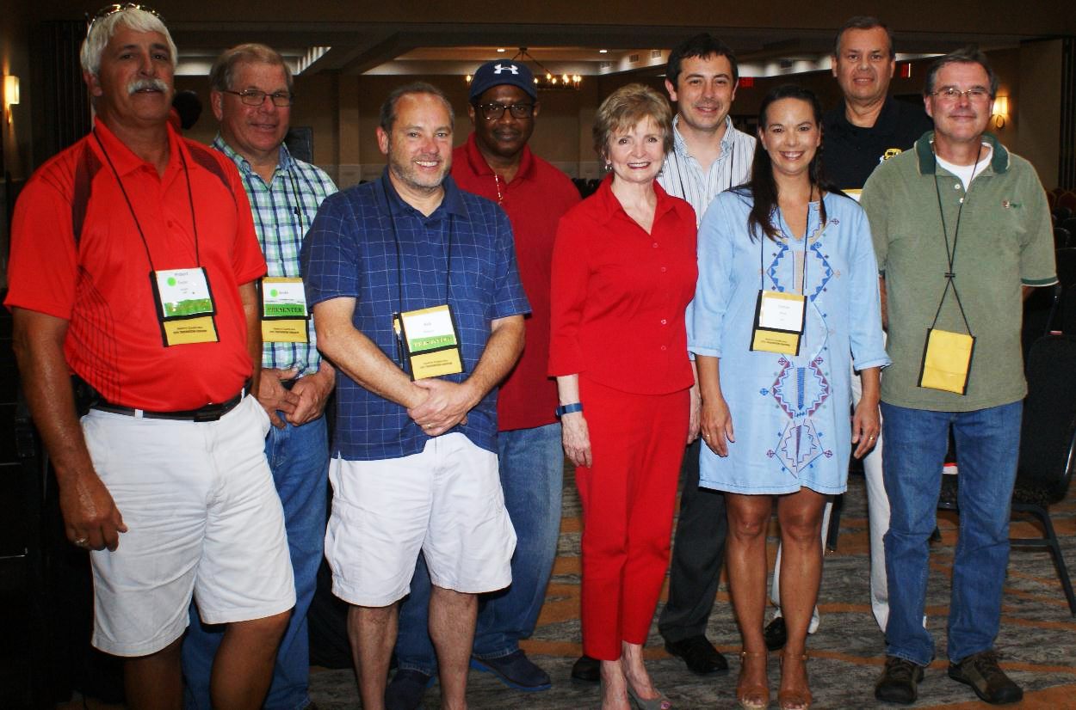
DPI Update
North Carolina Pupil Transportation Association
Annual Conference
June, 2016

Slide 2
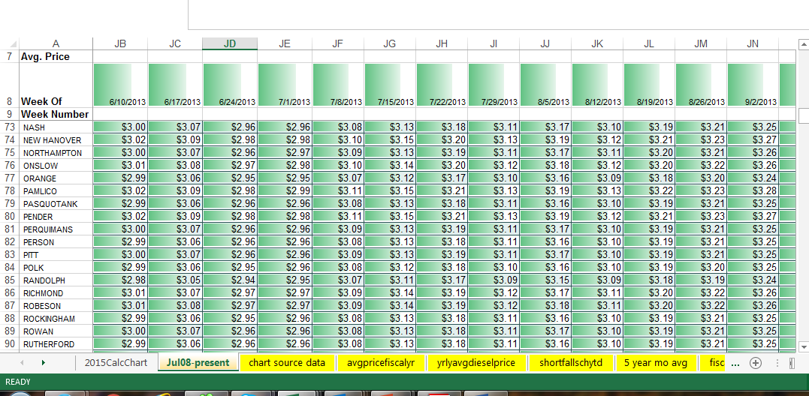
Weekly Fuel Pricing

Slide 3
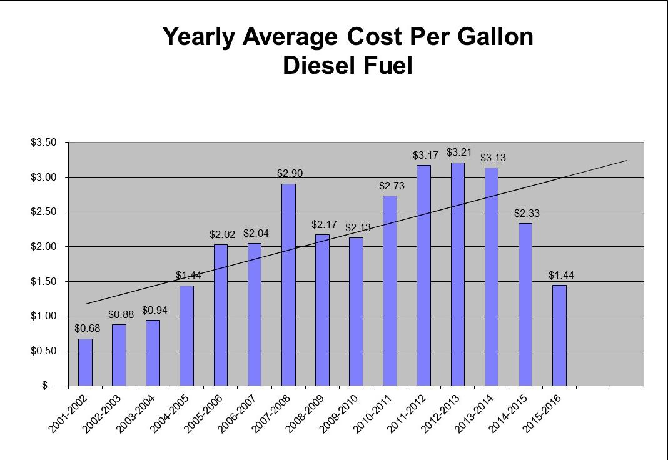
Fuel Cost

Slide 4
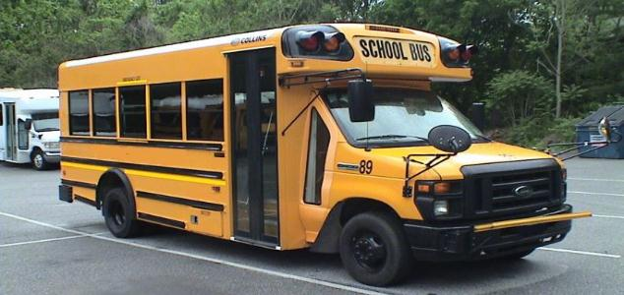
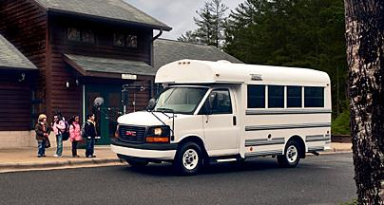
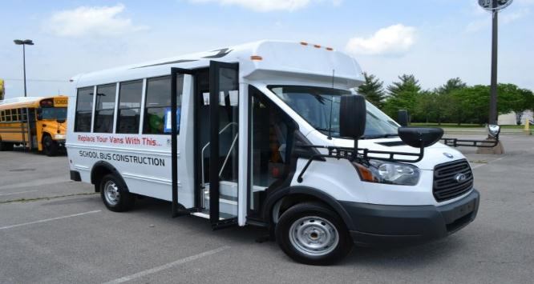
Type A Bid
Bid opening – July 5th
Menu Style Bid
Choose configuration, options and vendor
Careful review of questionnaire
Notes:
Although the bid opening is on July 5, It most likely will not be awarded and posted for a week or two afterwards.
Menu style bid is that the LEA can pick the configurations, options and vendors they want. LEAs are cautioned to read carefully the vendors responses to the questionnaire to be sure that they understand what the bus is that they are ordering.

Slide 5
Configurations
Item # | QTY. | UOM | DESCRIPTION | UNIT PRICE | EXTENDED PRICE
1 | 1 | Each | Small configuration – Gasoline Engine Passengers: Max 14 + driver Mfr: ___________________ Model #: _______________
2 | 1 | Each | Small Configuration – Diesel Engine Passengers: Max 14 + driver Mfr: ___________________ Model #: _______________
3 | 1 | Each | Medium Configuration Passengers: 18-25 + driver Mfr: ___________________ Model #: _______________
4 | 1 | Each | Larger Configuration Passengers: 26-30 + driver Mfr: ___________________ Model #: _______________

Slide 6
Option List
Upgrade from Manual Door to Electric
Backup Camera System Model:
Wheelchair lift with 1 Wheel Chair station Lift Model:
Wheelchair lift with 2 Wheel Chair stations Lift Model:
Wheelchair lift with flat floor and track seating Lift Model:
Downgrade from lap/shoulder belts to lap belts
39” seat
30” seat
other
Additional seats to increase capacity in same configuration
39” seat with Lap/Shoulder belts
30” seat with Lap/Shoulder belts
Other size seat with Lap/Shoulder belt. Size:
Other size seat with Lap belt. Size:
39” seat with Lap belt
30” seat with Lap belt
CSRS Seats (cost per seat) Model:
39” seat
30” seat
Other size seat. Size:
Luggage Containment Systems
Interior Overhead Luggage Racks
Exterior Luggage Compartments
Remote/Heated Mirrors
Vandal Locks
Activity Type Seats Model:
Maintenance Option

Slide 7
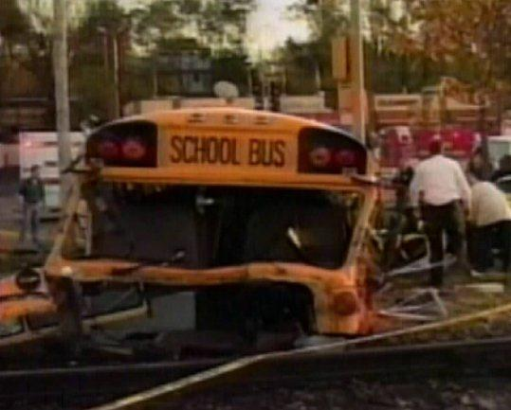
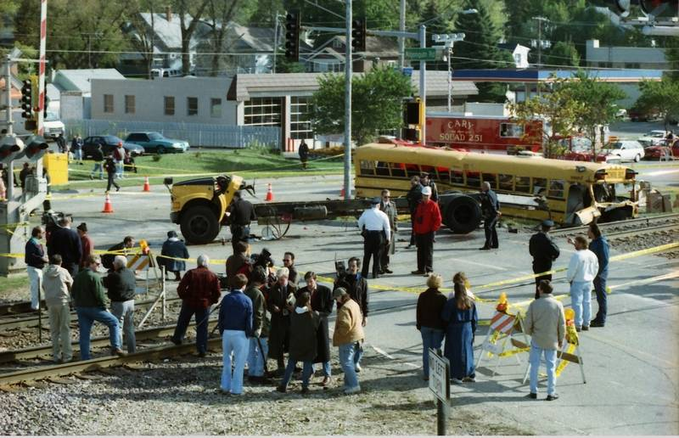
School Bus Safety – Railroad Crossings
Fox River Grove – October 1995

Slide 8
Railroad Crossings In TIMS
2016 NCPTA Summer Conference

Slide 9
Railroad Crossings Update
It is imperative that each LEA review the railroad crossing data in their TIMS map by the annual TDTIMS data audit due Tuesday, November 1, 2016
This data is needed to calculate how many students cross any Railroad Crossing in NC as an aid to determine which crossings are upgraded
Data is also used in TIMS to give the driver a warning of a Railroad Crossing in their driver directions
TIMS staff, partnering with the NC DOT Railroad Division, have found many errors in the current data and a thorough review is necessary

Slide 10
Example of Railroad Crossing in a Run Direction Report
Turnaround on SWAIN COUNTY WEST ELEMENTARY SCH DR
Turn Left on HWY 19 74 W
Turn Left on VETRANS RAMP
Turn Left on VETERANS BLVD
Turn Right on MAIN ST
Turn Left on EVERETT ST
Proceed on EVERETT ST
*RR XING*720196J
*RR XING*720196J
Proceed on FONTANA RD………
This is the warning to drivers

Slide 11
New Maps Available
NC Rail Division has provided 2 new PDF format maps for each LEA
One has closed and private crossings
The other map has current crossings with street names where crossing is located, along with a node number that identifies the crossing to NC Rail Division
These maps may be downloaded from your FTP folder, under the folder named “2016 Railroad Maps”

Slide 12
Sample - Grade Crossing Map
Public Grade Crossings – pay attention to these!
Private Grade Crossings – pay attention to these; do not add; take out if they exist

Slide 13
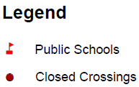
Sample - Closed Crossing Map
Double check these crossings to insure they are not identified as an active crossing in Maris

Slide 14
Information Needed
The basic info you need to create a warning:
Node 1 Node 2 Warning Message
For railroad crossings you need to 2 items:
Node 1 Node 2 ** RR XING** DOT # - provided on the maps

Slide 15
Pieces of the Puzzle
Maps from DOT show railroad numbers in their system
For their report, they need that number and it is clearly noted on the new maps that are in your 2016 Railroad File on FTP

Slide 16
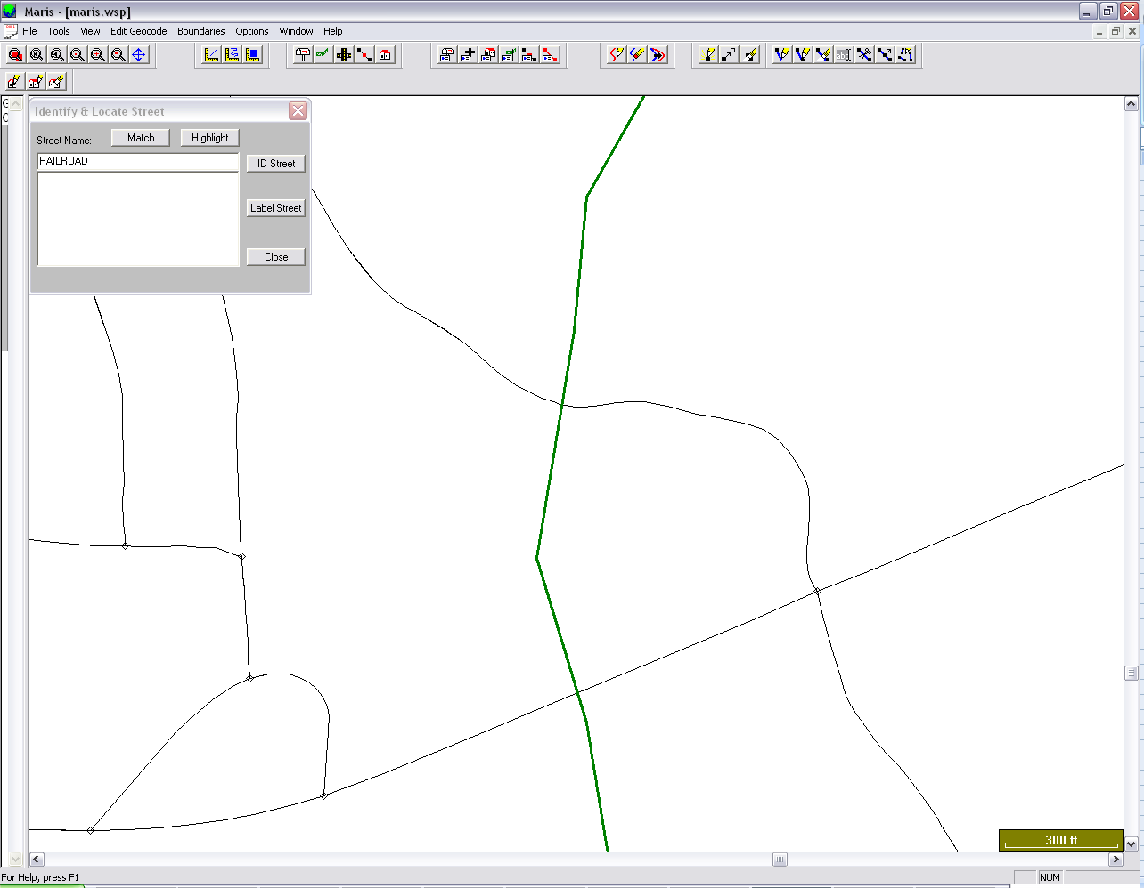
Proper Railroad Node Placement in MARIS
Split the Street Segment at Three Locations
Before the Crossing
At the Crossing
After the Crossing
Document the Node Numbers for later use

Slide 17
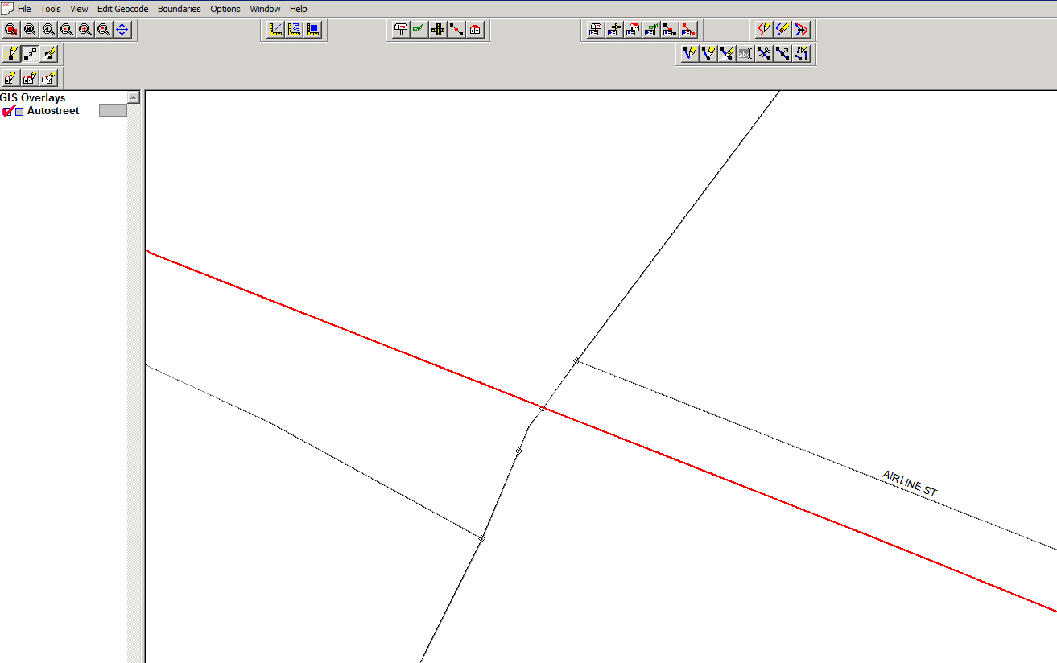
How it will look in Maris with segments split to note a Railroad Crossing
Railroad Crossing Placement
Crossing ID: 23895J
In this example, the bus could possibly cross at these node numbers:
5742 – 5743
5743 – 5744
5744 – 5743
5743 - 5742
5742
5743
5744

Slide 18
Updating the RRCRS.DAT File
After correctly splitting street segments and checking existing crossings, you are now ready to update the RRCRS.DAT File
By updating this file, you are making the railroad crossing information available in reports
Once the warnings are loaded using Buildtxt and running system maintenance, the Railroad Warnings will appear in printed Driver Directions.
The RRCRS Report, sent to NCDOT, will include the number of students who pass over the Railroad Crossing each day

Slide 19
DOT#
This is what the file looks like outside of Buildtxt; see the spacing between node numbers and the DOT number
The RRCRS.DAT File lists each crossing twice, to account for a bus crossing the Railroad from either direction.
Notice the design and format of each line of text.
It is very important to maintain the exact spacing to ensure the correct information is captured; using Buildtxt to make the edits insure proper spacing.

Slide 20
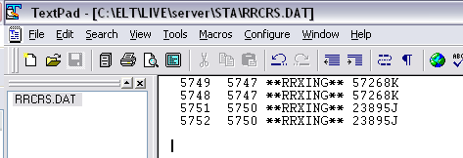
The order of the node number is important as it indicates the direction that the bus is travelling.
Example here - for the first line (5749 5747 **RRXING** 57268K), indicates the bus is travelling from node 5749 to node 5747, then it is to cross the railroad where the message **RRXING** 57268K will appear in driver directions.

Slide 21
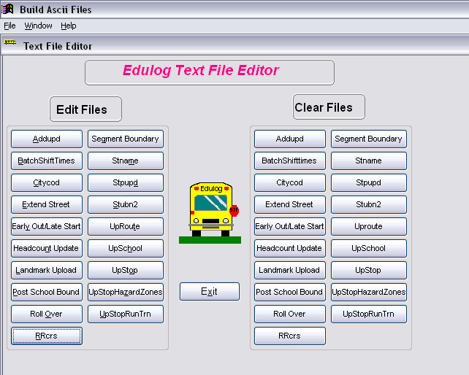
Examine Current RRCRS File
Using Launch Pad, Open BuildTxt.exe
Take look at the current file for RRcrs; choose EDIT RRcrs

Slide 22
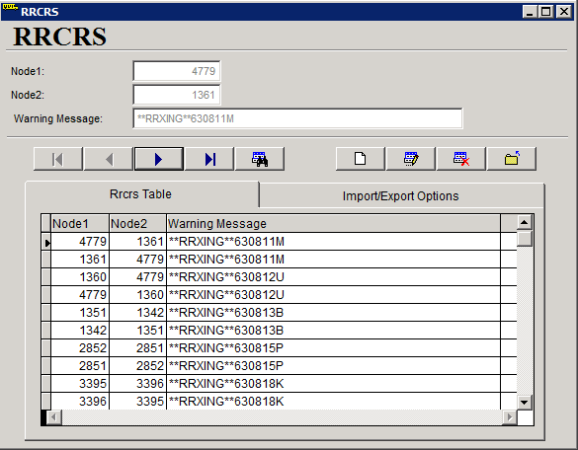
What RRCRS file should look like in BuildTXT

Slide 23
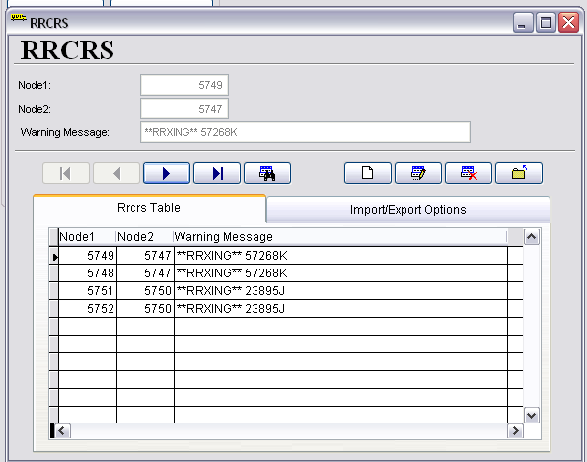
Browse through this table and double check that the changes you made are reflected
Select Exit Form when finished
Run the following EMU Batches
Rebuild Keys
Geocode Map Maintenance
Stop Scan (if needed)
Batch RTE Directions
Dumpall

Slide 24
Buildtext
All editing is done in the top fields
This program only builds the file
It must be exported before the system can use it
The tabs show the table and the import/export functions

Slide 25
Next Steps
There will be an upcoming Webinar to fully discuss these steps
Download your maps from FTP – they will be located in a folder named “2016 Railroad Maps”
TIMS project leaders are prepared to assist you in reviewing this project

Slide 26
TIMS
Conversions to eSQL – about 1/3 of counties converted
DEMO

Slide 27
Monthly Director’s Report – Kevin Harrison
BSIP Data
Showing your data to you
Summary and Outlier Information
Produced and Distributed Monthly
Sample Report will come the end of June covering the month of May

Slide 28
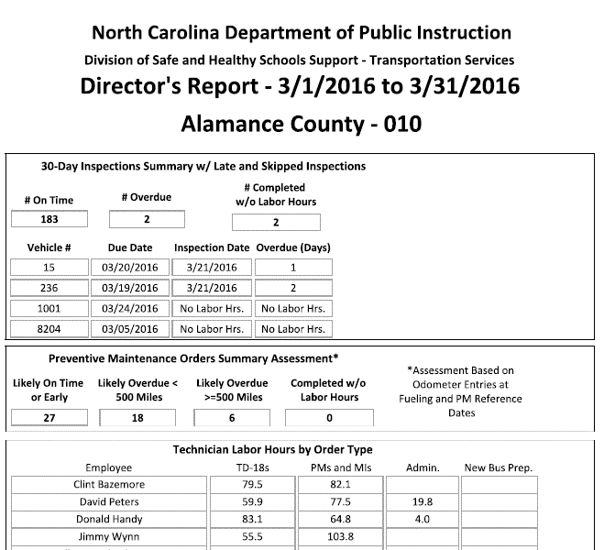
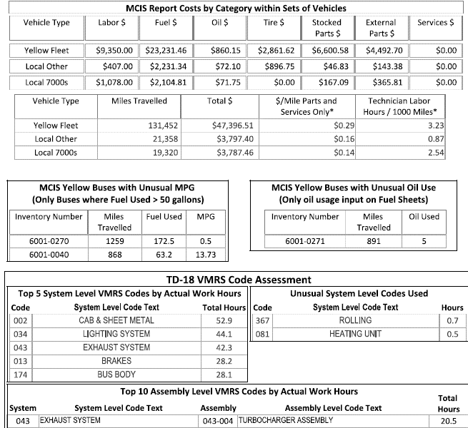

Slide 29
Primary Areas Covered
30-day Inspections
Mileage based PMs
Technician Labor Hours
Parts Purchasing Volume
Cost Summaries by Category of Operation (Local 7000s, Local Other, and Yellow Fleet)
Outliers in MPG and Oil Consumed
VMRS Codes
Top codes used by labor hours
Assessment of how much the codes are used

Slide 30
Feedback
Any data put in can be retrieved
Look it over give us ideas
It can’t necessarily have everything but we’ll look into all suggestions
We’ll be refining the report over the summer
Monthly distribution beginning with the new school year

Slide 31
Use It!
Once you have it, ask questions of your staff and ours
We can point you to more details on anything you’re concerned about

Slide 32
North Carolina School Bus Inspector Certification Program DPI Update
Notes:
10 minutes is allotted for this section (Slides 1-28)

Slide 33
History
House Bill 2265 states:
“AN ACT to exempt buses from safety inspections required under motor vehicle laws if they are titled to a local board of education and subject to school bus inspection requirements, as recommended by the joint legislative transportation oversight committee.
Section 1. G.S. 20-183.2 reads:
“(a1) Safety Inspection Exception – Historic vehicles, as defined in G.S. 20-79.4 (b)(55), shall not be subject to a safety inspection pursuant to this Article:
(1) Historic vehicles, as defined in G.S. 20-79.4 (b)(55).
(2) Buses titled to a local board of education and subject to the school bus inspection requirements specified by the State Board of Education and G.S. 115C-248(a)
This Bill was approved on August 4, 2008.
State Board of Education approves School Bus Inspector Program
Policy # TCS-H-011 on April 1, 2010. Effective August 1, 2011
LEAs shall require each 30-day inspection required under G.S. 115C-248 to be conducted by an individual who has completed the training and certification requirements administered by the Department of Public Instruction.
Notes:
1) Overview of DMV inspection sticker exemption as written in the NC law. Buses are no longer inspected by DMV
2) NC Board of Education policy requiring all bus inspectors to become state certified.

Slide 34
The objective of this program is to;
-Support of the educational process of School Bus Inspectors.
-Strive for the maximum operational efficiencies.
-Provide for maintenance integrity and consistency.
-Provide safe & reliable transportation services for students.
-Create an environment in which our employees can reach
their fullest potential.
-Inspire the confidence, trust, and respect of the general public.

Slide 35
Interesting info….
197 four hour sessions have been taught since implementation of
the program over 5 years ago.
2900+ attempts at the written test.
1300+ inspectors certified.
Overall passing rate average-85.9% (for those who passed)
672 passed on first attempt
79% passed on 2nd attempt
Only 2 perfect scores were achieved for closed book version during
original testing cycle.
-Ronald Topping- New Hanover ( August 2011)
-Darryl Barnes- Pender (January 2015)

Slide 36
School Bus Inspector Certification (original)
Inspector applicant must first be thoroughly familiar with the NC FLEET MANUAL- 30 DAY INSPECTION SECTION.
Upon completion of the four hour class the inspector applicant may attempt the 50 question NC school bus inspector test. If passing score of 80 is achieved an inspector certificate will be issued from NCDPI.
If failure to pass on 1st attempt, Inspector applicant must complete a training regimen as directed by LEA Transportation Director (process must be documented and recorded in employee’s personnel file). Inspector applicant will take the 50 question NC school bus inspector
Notes:
36

Slide 37
School Bus Inspector Certification (original) continued…
If failure to pass on 2nd attempt, Inspector applicant must re-attend a four hour NC school bus inspector training session within 90 days before attempting the 50 question NC school bus inspector test. If passing score of 80% is achieved an inspector certificate will be issued
from NCDPI.
If failure to pass on 3rd attempt, the inspector applicant may repeat step 4 after a 3 month waiting period.
Notes:
37

Slide 38
Renewal of Inspection Certification
Bus inspector must renew inspection certification before June 30th of the 5th calendar year from original certification date.
For eligibility to take renewal test, Bus inspector must attend a minimum of 20 hours of in service training every 5 years and provide documentation of in-service training that shall be kept in employee’s personnel file.
The bus inspector must pass a 50 question NC school bus inspector test. If a passing score of 80% is achieved the bus inspector will be issued an inspection certificate from NCDPI.
If failure, retake the 4 hour class & test.
An inspector must take renewal test within 365 days of expiration OR begin program same as a new inspector (if more than 365 days lapses).
Notes:
38

Slide 39
Qualifying classes for 20 hour renewal requirement
Any appropriate training course sponsored by NCPTA.
Any appropriate training course sponsored by NCDPI
Any appropriate training course sponsored by LEA bus inspector trainer.
Other training courses may qualify with prior approval from NCDPI.
Example- Training by vendors, ASE classes.
Notes:
39

Slide 40
Transfer of NC Bus Inspector Certification
A school bus inspector may transfer the Inspector Certification to any LEA in North Carolina if employment is secured at a new LEA location.
The Transportation Director who gains the transferred employee will be responsible to see that NCDPI is notified of the location change.
The Transportation Director who gains the transferred employee will be responsible to see that an inspector certificate is displayed at the LEA bus garage location before the employee begins performing 30 day inspections.
Notes:
40

Slide 41
Hands-on Spot Testing
Bus inspector is subject to random unannounced hands-on testing by NCDPI personnel. Spot testing will consist of performing a correct 30 day inspection and brake stroke measurement demonstration.
If bus inspector unsatisfactorily completes 30 day inspection and brake stroke measurement demonstration, the bus inspector will required to attend the next available four hour NC bus inspector training session. The Transportation Director will be responsible to keep track of any additional training as required by NCDPI.
If bus inspector fails to comply with #1 and/or #2, NCDPI will revoke bus inspector certification until attending a 4 hour class and re-taking 50 question test.
Notes:
41

Slide 42
ROLE OF THE FIELD CONSULTANT
-ANNUAL INSPECTIONS
Robert Taylor, Central Field Consultant

Slide 43
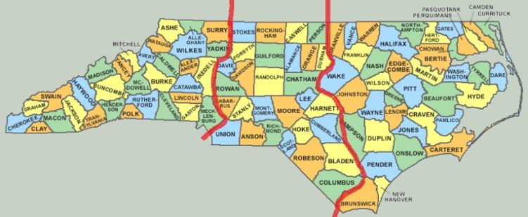
NCDPI FIELD TRANSPORTATION CONSULTANTS
Randy Henson
Robert Taylor
Keith Whitley
Employed by N.C. Department of Public Instruction

Slide 44
Yearly annual inspection review
Inspect 10% of yellow fleet
Inspect small number of Activity buses
Observe small number of bus inspectors
Review office records (5 page check list)
Audit bus parts inventory
Send a letter to superintendent of review results
Compare results from year to year
Inspect state service trucks (summer visit)
Identify and list buses & trucks to be sold
Determine if EZ buses should be disposed.

Slide 45
30-Day Inspection Processing Changes
Each night an inspection will be made available for any vehicle without one
An inspection remains on the list (ZIP24 in BSIP) until it is completed
If the bus is down for service (or the summer) and will not be operated, keep the inspection until it is needed
DO NOT complete orders without time

Slide 46
Advantages
No unnecessary paperwork printing, processing, and filing
The due date on the inspection is the real due date. You don’t have to refer to the file to find the last real inspection.
No new inspection will generate until the existing one is complete, so there will never be two at the same time
Use the ZIP24 list to manage vehicles available throughout the summer

Slide 47
Example
Bus 500 is out of service for engine repair but has an inspection due February 12th
It is out of service until it returns on April 10th
April 10th the inspection is performed
Use the February inspection on April 10th (reprint if needed)
Entered the inspection into BSIP on April 11th
April 12th, in the morning, there will be another inspection available due May 10th
No other paperwork processing is necessary

Slide 48
Role of the field Consultant Wrecks & Major repairs
When should the field consultant be involved?
Keith Whitley-Eastern Transportation Consultant

Slide 49
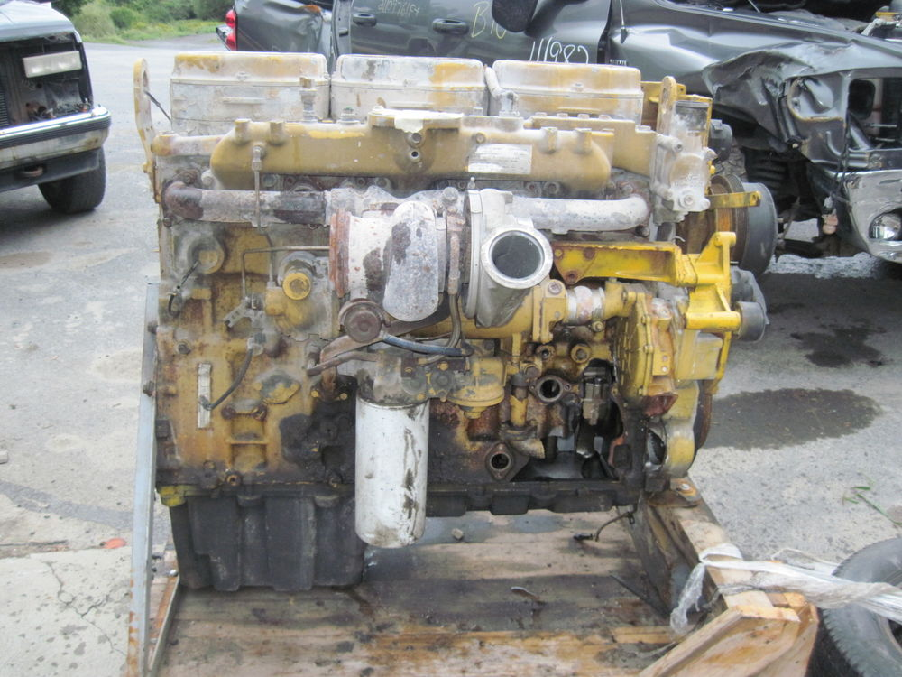

Slide 50
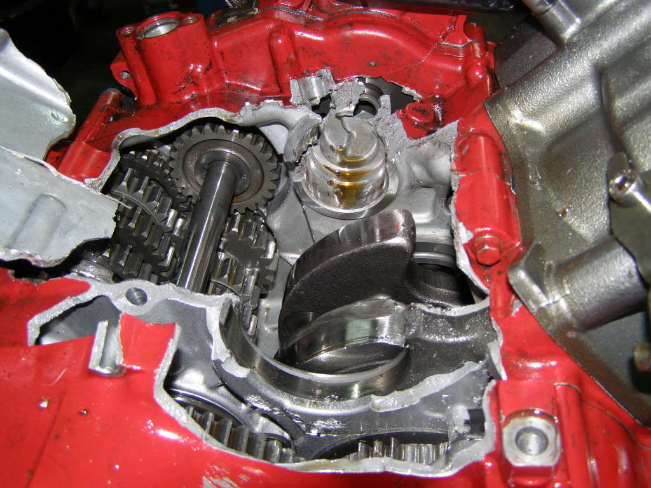

Slide 51
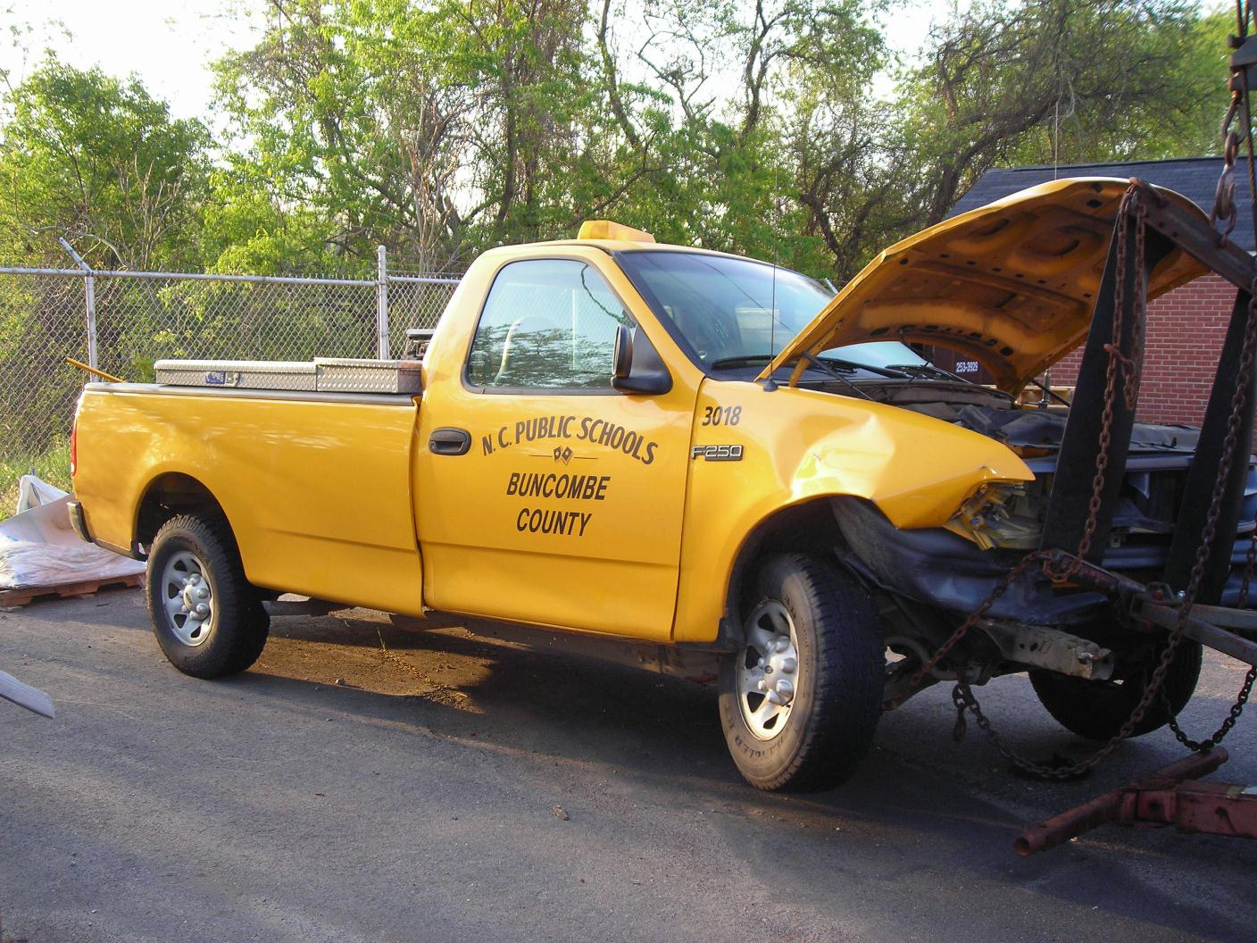

Slide 52
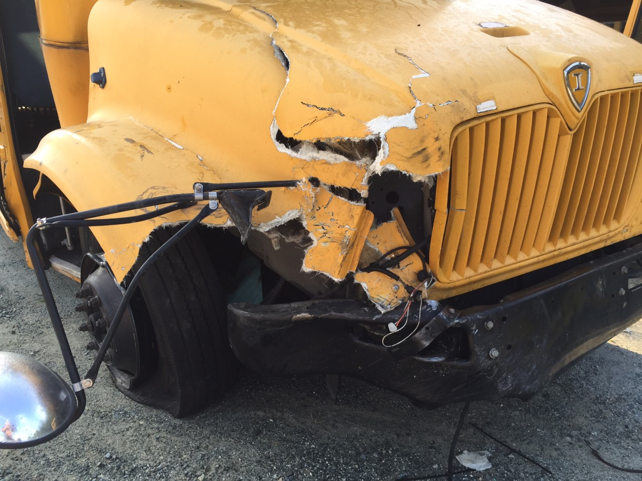

Slide 54
Line |  | Formula
1 | Purchase Price of Bus | P | $62,559
2 | Annual Depreciation Based on 20 Years | P / 20 | $3,128
3 | Number of years bus has left in service (excluding 2+ years as operational spare vehicle) | 20 - (Service Years) | 14.0000
4 | Remaining Use Value Based on Years Remaining (Purchase price less depreciation) (3) x (2) | (P/20) x Y | $43,791.30
5 | Depreciation Basis - Mileage (200,000 miles; 165,000 miles for pre-1994) | M | 200,000
6 | Current Mileage | C | 102,913
7 | Remaining Use Value Based on Miles (6)/(5) x (1) | ((M-C)/M) * P | $30,368
8 | CURRENT VALUE - LESSER OF (4) & (7) | V | $30,368
9 | Sale Value at end of life | S | $6,000
10 | Salvage value of wrecked bus based on recent sales to scrap metal dealers. | W | $2,000
11 | Value to State if LEA keeps the Bus | V+S-W | $34,368
12 | Value to State if insurance company takes the bus | V+S | $36,368

Slide 55
Training Presentations, Offerings &Resources
Updated Bus Stop Video
School Loading Zone Safety
Emergency Evacuation Video
Emergency Evacuation Brochure
Updated School Bus Safety Minutes (from website)
Resources

Slide 56
Overview | State Trends | LEA Profiles | Involvement
Purpose
The integration of stop arm cameras into the North Carolina school bus fleet provides an opportunity to:
Report school bus stop arm violations to local and state law enforcement authorities
Understand trends and factors associated with school bus stop arm violations

Slide 57
Reporting: State LEA Participation
Overview | State Trends | LEA Profiles | Involvement
Q: Which Local Education Agencies are involved?
A total of 61 Local Education Agencies (LEAs) out of 115 LEAs in North Carolina submitted stop arm violation data via the NC DPI data collection survey during the 2015-2016 school year.
With 53% participation, these participating LEAs are contributing to the construction of one of the largest stop arm violation databases in the United States.

Slide 58
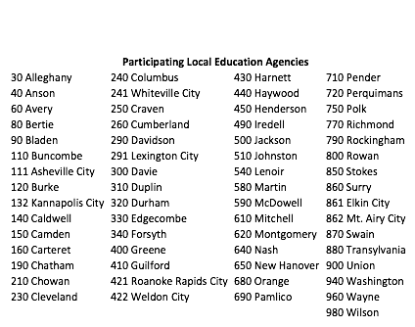
Overview | State Trends | LEA Profiles | Involvement

Slide 59
Understanding: State Trends
Overview | State Trends | LEA Profiles | Involvement
Q: How many violations were reported in 2015-16
Q: What are LEAs doing with violation data?
From the 61 participating LEAs, 845 violations were reported via the survey database in 2015-2016.
Of these, 91% (767) were referred to law enforcement.
Reasons for not submitting most frequently entailed blurred or nonexistent NC license plates.

Slide 60
Understanding: State Trends
Overview | State Trends | LEA Profiles | Involvement
Q: Are there more violations in the morning or afternoon?
Of the 845 violations reported via the survey database, most violations occurred in the afternoon.
321 Stop Arm Violations in the AM Time Period (40%)
479 Stop Arm Violation in the PM Time Period (60%)
Note: These findings are consistent with AM/PM split from 2016 one-day stop arm violation count in North Carolina (42.1% AM / 56.7% PM)

Slide 61
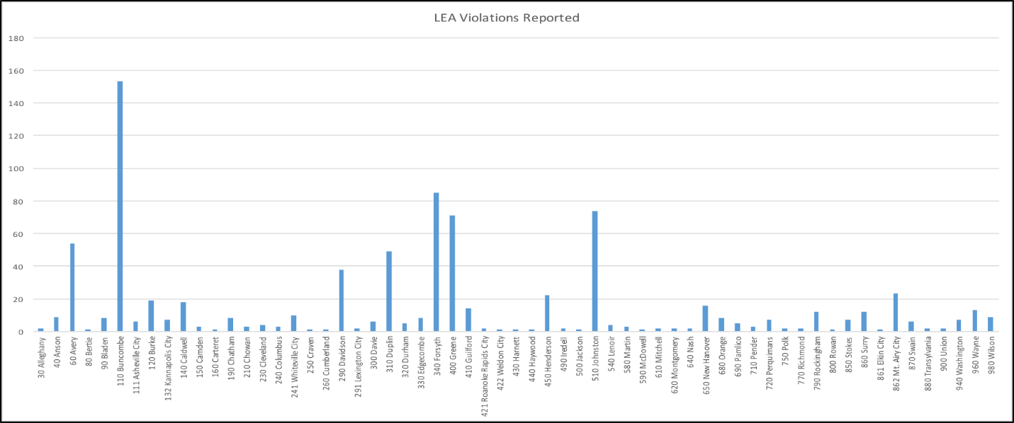
Observed: LEA Stop Arm Violations
Overview | State Trends | LEA Profiles | Involvement
Q: How many violations were reported by each participating LEA?

Slide 62
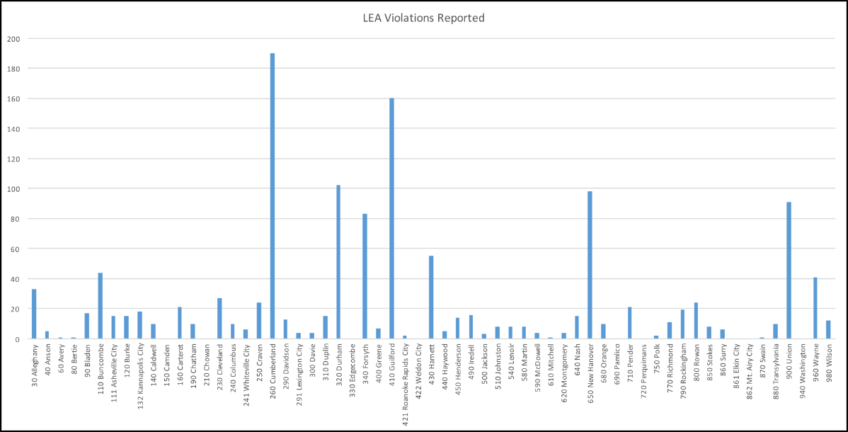
Factor: One-Day Stop Arm Violations
Overview | State Trends | LEA Profiles | Involvement
Q: What were the one-day stop arm violation counts for each participating LEA?

Slide 63
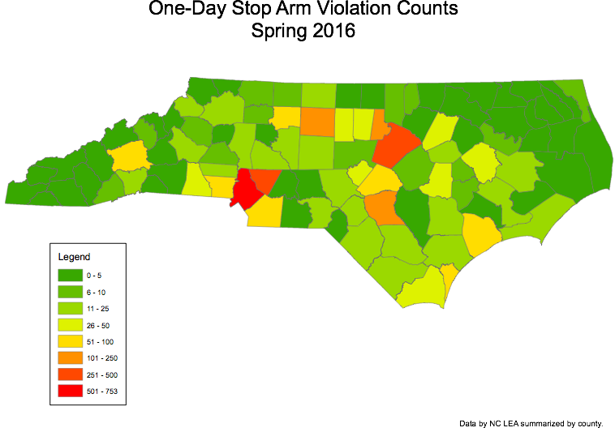
Factor: One-Day Stop Arm Violations
Overview | State Trends | LEA Profiles | Involvement
Q: What were the one-day stop arm violation counts for each participating LEA?

Slide 64
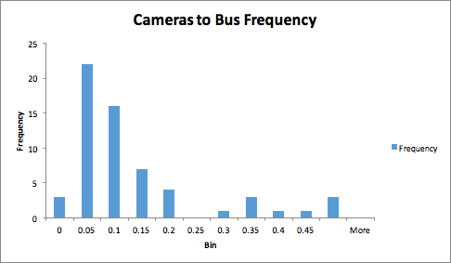
Factor: Camera Equipped Buses
Overview | State Trends | LEA Profiles | Involvement
Q: What percentage of LEA buses are equipped with cameras?
Participating LEA Buses With Cameras (561) = 8.0%
Participating LEA Buses Total (6,930)

Slide 65
Student Count 2016 – Webinar / Observations

Slide 66
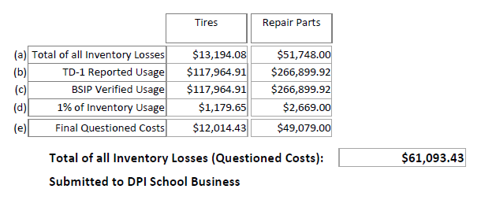
Questioned Costs

Slide 67
How Big Was the Problem?
~8-10 Counties appear to have performed no full inventory of stock on hand in 13-14
Reported Stock Losses in 2013-14
$2,234,144 across ~11 thousand line item losses
Losses Ranged from $0 - $466k in each County
36 Counties reported losses greater than $10,000
16 of those 36 reported losses greater than $30,000
Half of those 16 reported losses greater than $100k
These are things that SHOULD have been on hand and available to use, were not knowingly stolen or the result of a known data error, and yet could not be found

Slide 68
How Big is the Problem? UPDATE!
Reported Stock Losses in 2014-15
$900k across ~8k thousand line item losses
Losses Ranged from $0 - $164k in each County
17 Counties reported losses greater than $10,000
7 of those 17 reported losses greater than $30,000
Only 3 reported losses greater than $100k
$332,098 in bulk fluids were offset
$86,463 in non-fluid offset requests were accepted
$373,792 in questioned costs were reported and billed to LEAs

Slide 69
2015-16 Year School Year Losses
There are no planned changes in the process
Bulk fluids will be excluded
LEAs will have an opportunity to give explanations about why items showing losses were not losses

Slide 70
Injury Data
Bus Injury Incidents | Bus Injury with School Transportation Vehicle Involved | Incidents where School Transportation Driver Charged | Incidents where another unaffiliated vehicle was involved
432 | 356 | 171 | 241
 | 82% | 40% | 56%
Incidents where a passenger injury was sustained | Pedestrian Injuries | Was other vehicle charged
63 | 34 | 325
15% | 8% | 75%

Slide 71
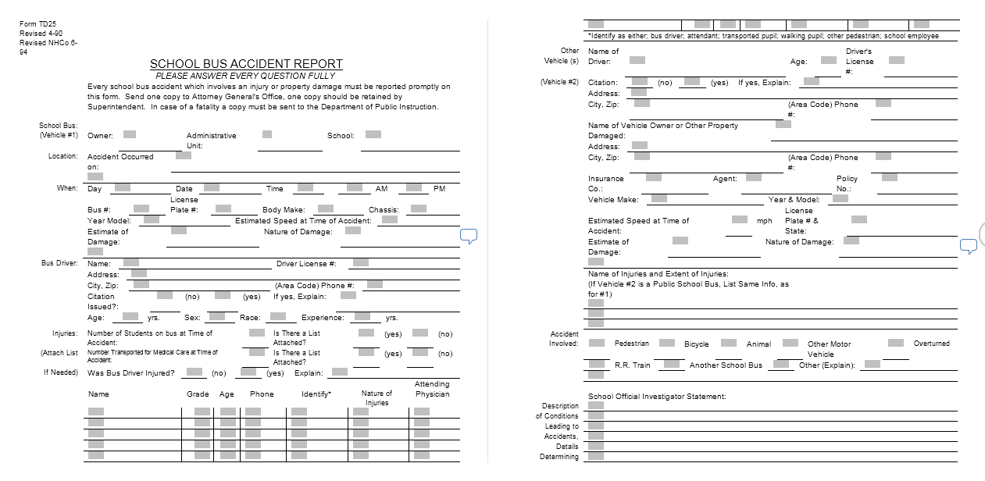
Accident / Injury Project

Slide 72
Hurricane Evacuation Support

Slide 73
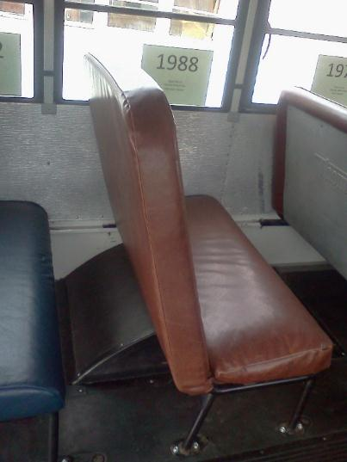
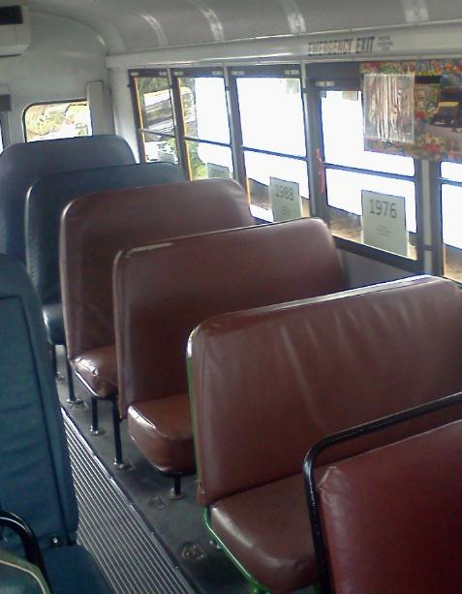
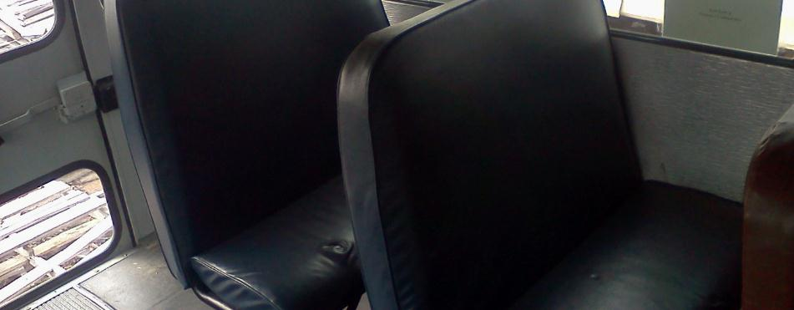
Evolution of School Bus Seating

Slide 74
Why Don’t School Buses Have Seat Belts? The answer is changing…

Slide 75
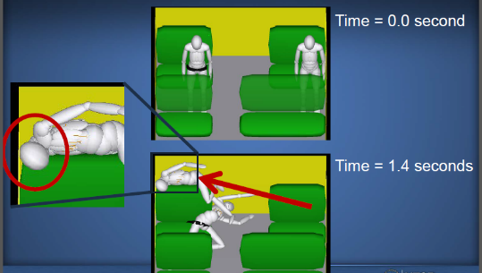
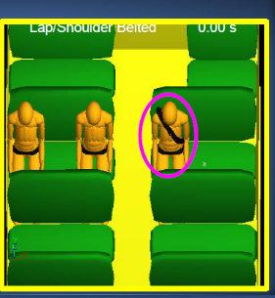
National Transportation Safety Board Studies of Fatal Crashes
Students using a lap/shoulder belt fared significantly better than those using a lap belt or no restraint system at all

Slide 76
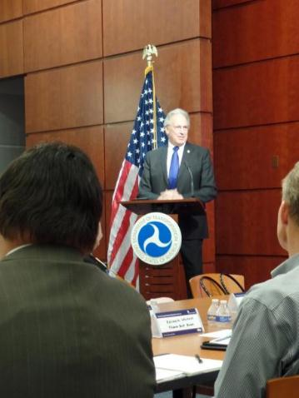
National Association for Pupil Transportation – November, 2015
NHTSA Administrator, Dr. Mark R. Rosekind: “School Buses Should Have Seat Belts. Period”

Slide 77
Improved Student Behavior Video Evidence

Slide 78
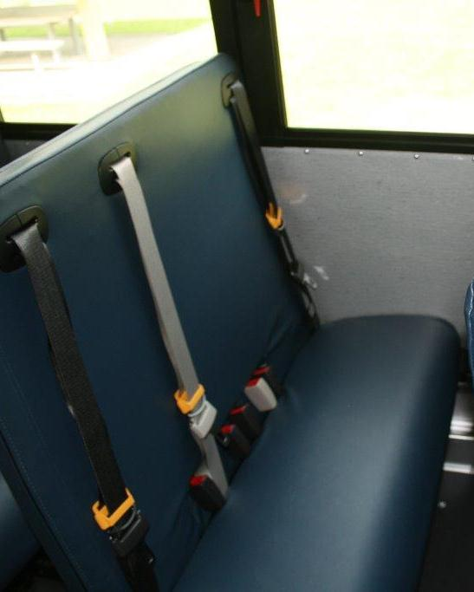
82 Buses, 11 Counties

Slide 79
New Schoolbus List
GovDelivery
Improved graphics and tracking
Cannot reply to the message, which comes from “North Carolina Public Schools”
If you need to send a message to the SCHOOLBUS list, send it to the Raleigh office and we will forward it for you.
Discussing with NCPTA varios

Slide 80
DPI UPDATES

Slide 81
Allotment Summary

Slide 82
Legislative Update

Slide 83
Directors –
we’ll see you on July 28 in Guilford County
(not restricted to just Directors)

Slide 84
DPI Update
North Carolina Pupil Transportation Association
Annual Conference
June, 2016

